Slide 1
PSOC™ Edge E84 Introductory Training
(Level E2)
Presenter: TBD | Content by: Mohan Kumar
October 2025
Notes:
Hello attendees, a warm welcome to all of you. This presentation provides an overview of the development ecosystem and resources available for PSOC Edge E84.
It also explains how to get started on PSOC Edge E84 through code examples at the end of the presentation.

Slide 2
Agenda
Development ecosystem for PSOC™ Edge E84
    Resources ( Documentation / Application Notes )
    Firmware / Application Development ( ModusToolbox™ )
Code Example #1: Hello World
Code Example #2: IPC queues using HAL
Notes:
Now let us look at today’s agenda. We will cover the
Development Ecosystem for PSOC™ Edge E84
Some technical details related to Boot sequence, device life cycle, and memory layouts discuss through the relevant sections
Code Example 1 – Hello World
Code Example 2 – IPC Queues using HAL

Slide 3
PSOC™ Edge E84 Resources
PSOC™ Edge E84 MCU
Datasheets
Reference manuals (RM): architecture and registers
Application notes
Code examples
Development kits
KBAs and community forum
Contact internal team for all above documents or use Early Access Pack
Notes:
Here is the list of PSOC Edge E84 resources. Resources play a vital role in the success of any product.
[Press Enter for animation] PSOC™ Edge E84 MCU product page for PSOC™ Edge E84 MCU related documents
[Press Enter for animation] PSOC™ Edge E84 MCU datasheets that describe and provide electrical specifications for each device family
[Press Enter for animation] Technical reference manuals (TRMs) provide detailed descriptions of the architecture and registers in each device family.
[Press Enter for animation] Application notes and Code examples cover a broad range of topics, from basic to advanced. You can browse our collection of application notes and code examples

Slide 4
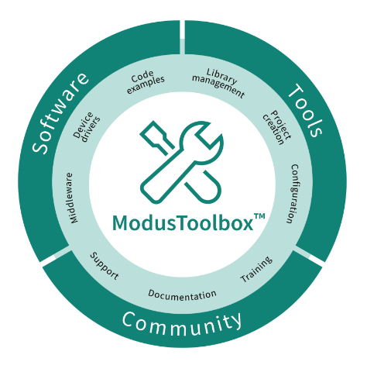
Firmware / Application Development
ModusToolbox™ provides
  Development environment for Infineon MCUs
  Flexible set of tools for project and system
  level configuration
  Low-level drivers
  Libraries
  Operating system support (Linux, macOS,
    Windows)
    Reference link : https://www.infineon.com/ModusToolboxInstallguide
Notes:
For Firmware or application development, development tools are necessary.
ModusToolbox™ Software is a modern, extensible development environment supporting a wide range of Infineon MCUs, including PSOC Edge E84.
The ModusToolbox™ tools package includes tools and configurators for creating your application, managing it and configuring your device. This means you choose your compiler, IDE, RTOS, and ecosystem without compromising usability and can create applications easily to leverage our industry-leading CAPSENSE™ (Human-Machine Interface), AIROC™ Wi-Fi and Bluetooth®, security, and various other features.
It also comes with the build system infrastructure that helps you control the build flow and build your application using make across platforms.

Slide 5
Support for other IDEs
ModusToolbox™
IDE Tool Support
Eclipse IDE
Visual Studio
Code
IAR
Embedded
Workbench
Arm® MDK
µVision
Command-line Interface
Notes:
ModusToolbox™ software supports 3rd-party IDEs like Eclipse IDE, Visual Studio Code, Arm® MDK (μVision), and IAR Embedded Workbench. The tools package includes Eclipse IDE for your convenience. Additionally, a command line interface is also available for developers who prefer working without a graphical interface.
In the next section of this video walk through tools like Project Creator, Library Manager, and a few of the configurators available in ModusToolbox for PSOC Edge Development.

Slide 6
Tools utilized in this video
ModusToolbox Tools Package v3.3.0
Eclipse IDE for ModusToolbox™ v3.3.0
ModusToolbox™ PSOC™ E84 Early Access Pack v0.2.5
Edge Protect Tools v1.1.0.1333
Key documentation leveraged in this video
AN235935 – Getting started with PSOC™ Edge E84 on ModusToolbox™ software
ModusToolbox™ PSOC™ E84 Early Access Pack Release Notes

Slide 7
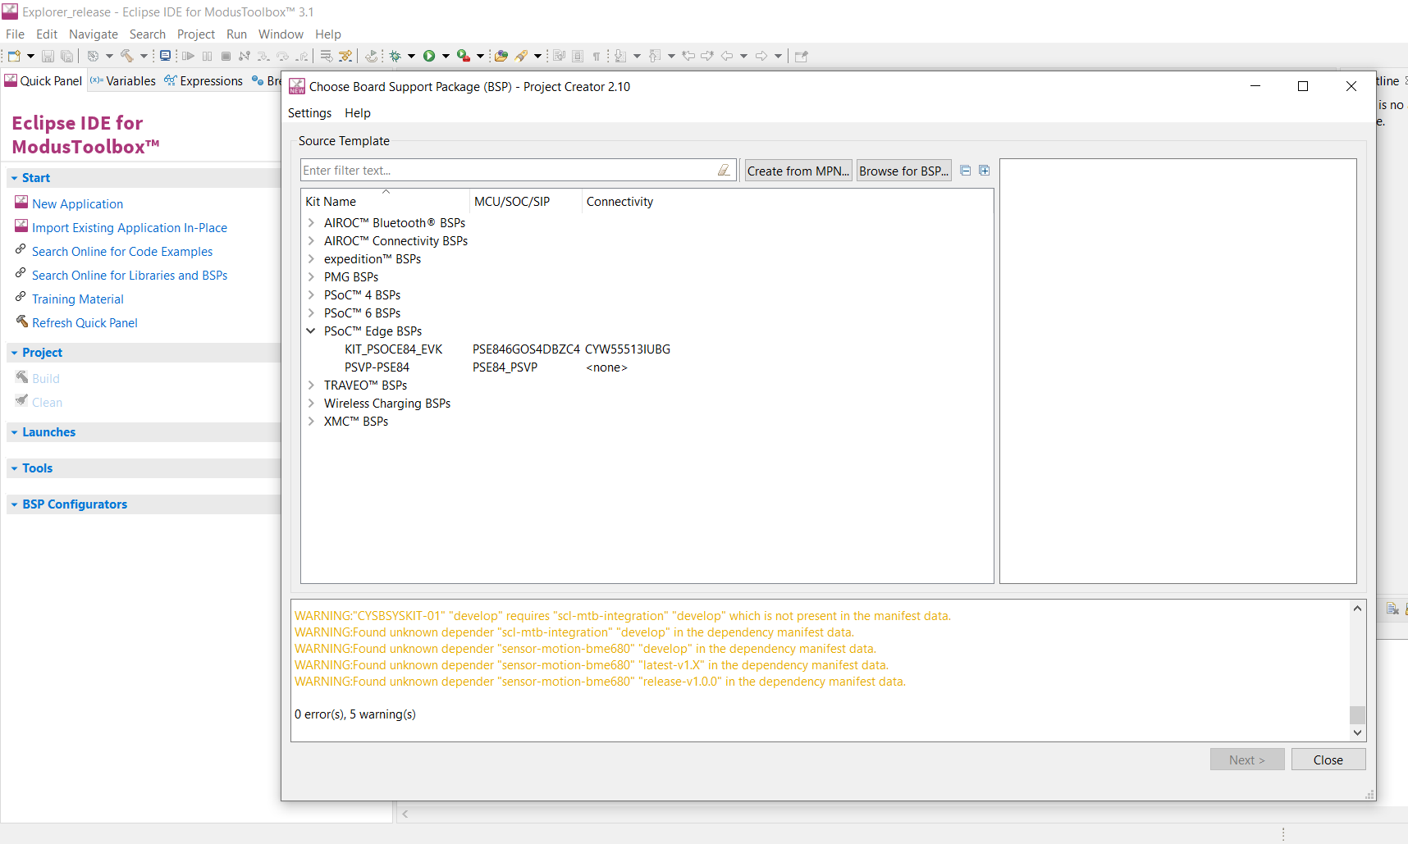
Project Creator
Notes:
(Will show actual tool)
At first, we have the Project Creator tool.
The Project Creator tool is used to create applications targeting specific Board Support Packages (BSPs) from available code example templates.
It is available both as a graphical user interface (GUI) and a command-line interface (CLI) to create applications for use in any software environment as per preference.
To launch Project Creator,
Open Eclipse IDE for ModusToolbox™
[Press Enter for animation] Launch Project Creator by clicking New Application in the Quick Panel
[Press Enter for animation] Project Creator lists all the BSPs you can select from
[Press Enter for animation] The PSOC Edge E84 MCU development kit is listed as KIT_PSOCE84_EVK under PSOC Edge BSPs. We will be using this in our training, please take note of it.
You can also launch the tool standalone by running the executable of the tool.

Slide 8
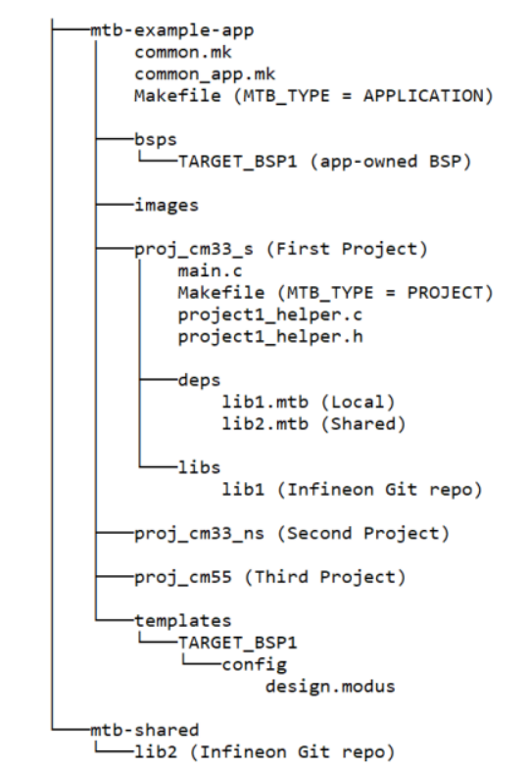
Understanding the Application Structure
Notes:
(Will show actual tool)
After creating an application, it will be located in a top-level container, or workspace directory, that contains multiple files, one or more application directories, plus a mtb_shared directory.
A typical PSOC edge application contains three projects: Proj_cm33_s (s stands for secure), Proj_cm33_ns (s stands for non secure) and proj_CM55
common.mk :
This makefile is shared across all projects. It contains variables including: MTB_TYPE, TARGET,TOOLCHAIN, and CONFIG. In this case, we have a multi-project structure for all Explorer MCU applications, hence MTB_TYPE=PROJECT. This file includes a reference to the common_app.mk file
common_app.mk
This makefile is shared across the entire application and all its projects. It contains path information to indicate the location of the installation tools_version directory
Application Level Makefile
An application contains a Makefile which is in the application's root folder. This file contains the set of directives that the make tool uses to compile and link the application project. This Makefile contains the MTB_TYPE variable set to APPLICATION, plus the MTB_PROJECTS variable to specify the included projects. This file also includes the common_app.mk file and the path information to the application.mk file in the installation tools_<version> directory. This is responsible for forwarding build-related requests to the individual core projects and dealing with post-build activities (for example, generating single monolithic HEX files that can be used to program all projects simultaneously) when they are complete.
bsps folder
The bsps folder is common to all projects in a multi-core application. The files provided by the BSP are present here and are listed under TARGET_<bsp name> sub-folders. All the input files for the device and peripheral configurators are in the config folder inside the BSP. The Generated Source folder in the BSP contains the files that are generated by the configurators and are prefixed with cycfg_. These files contain the design configuration as defined by the BSP. From ModusToolbox™ 3.x or later, you can directly customize configurator files of BSP for your application rather than overriding the default design configurator files with custom design configurator files since BSPs are completely owned by the application.
The BSP folder also contains the linker scripts and the start-up code for the Explorer MCU used on the board.
main.c file
This is the file containing the source code of the project. Each project has its own source code file. If a project has multiple source code files, they can be grouped under a "source" folder
Project Level Makefile
This is the project's Makefile. It includes numerous variables used for the projects, such as COMPONENTS, CORE, CORE_NAME, and other variables used to specify flags and pre-build and post build commands. This file also includes path information for source code discovery, shared repo location, and path to the
complier. Plus, it includes the common.mk file from the application and the path information to the start.mk file in the installation tools_ directory
libs folder
The libs folder also contains .mtb files. In this case, they point to libraries that are included indirectly as a dependency of a BSP or another library. For each indirect dependency, the Library Manager places an .mtb file in this folder. These files have been populated based on the targets available in deps folder. For example using BSP KIT_PSOCE84_EVK populates libs folder with the following .mtb files:cmsis.mtb, core-lib.mtb, core-make.mtb, mtb-hal-cat1.mtb, mtb-pdl-cat1.mtb, recipe-make-cat1d.mtb The libs folder contains the file mtb.mk, which stores the relative paths of the all the libraries required by the application. The build system uses this file to find all the libraries required by the application. Everything in the libs folder is generated by the Library Manager so you should not manually edit
anything in that folder
build folder
The build folder contains all the artifacts resulting from a build of the project. The output files are organized by target BSPs
deps folder
The deps folder contains .mtb files, which provide the locations from which ModusToolbox' pulls the libraries that are directly referenced by the application. These files typically each contain the GitHub location of a library. The .mtb files also contain a git Commit Hash or Tag that tells which version of the
library is to be fetched and a path as to where the library should be stored locally
For example, Here, retarget-io.mtb points to mtb://retarget-io#latest-v1.X#$$ASSET_REPO$$/retarget-io/latest-v1.X. The variable $$ASSET_REPO$$ points to the root of the shared location which defaults to mtb_shared. If the library must be local to the application instead of shared, use $$LOCAL$$ instead
of $$ASSET_REPO$$.This subdirectory also contains the locking_commit.log file, which keeps track of the version for each dependent library
mtb_shared folder
By default, when creating a new application or adding a library to an existing application and specifying it as shared, all libraries are placed in an mtb_shared directory adjacent to the application directories.The mtb_shared folder is shared between different applications within a workspace. Different
applications may use different versions of shared libraries if necessary Each workspace you create with one or more applications will include a mtb_shared directory adjacent to the application directories, and this is where the shared libraries are cloned by default. This location can be modified by specifying the CY_GETLIBS_PATH variable. Duplicate libraries are checked to see if they point to the same commit, and if so, only one copy is kept in the mtb_shared directory. You can regenerate these files using the Library Manager as and when needed
Similar project structure can be observed in our created hello world project

Slide 9
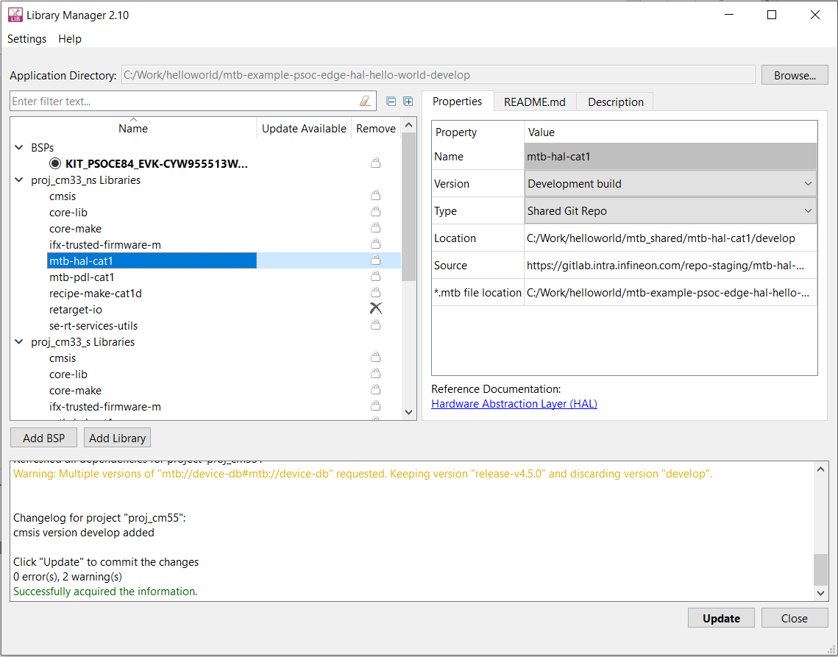
Library Manager
Notes:
(Will show actual tool)
Next we have the Library Manager
The Library Manager provides a GUI to select which Board Support Package (BSP) and version should be used when building a ModusToolbox application.
The tool also allows you to add and remove libraries, as well as change their versions for the selected project. This way you can easily manage libraries without having to create a new project.
Launch library manager from windows. Click Browse and point to the application directory.
[Press Enter for animation] The tool will list all the libraries, middleware's and BSP’s added for each project in the application
[Press Enter for animation] Once you click on particular library, Properties tab on the right hand side shows the details of the library like name, version, type etc. Specific versions can be selected using the properties tab
[Press Enter for animation] More BSPs can be added using “Add BSP”,
[Press Enter for animation] More libraries can be added using “Add library”
[Press Enter for animation] Once all the changes are made, click on Update for changes to reflect in your project

Slide 10
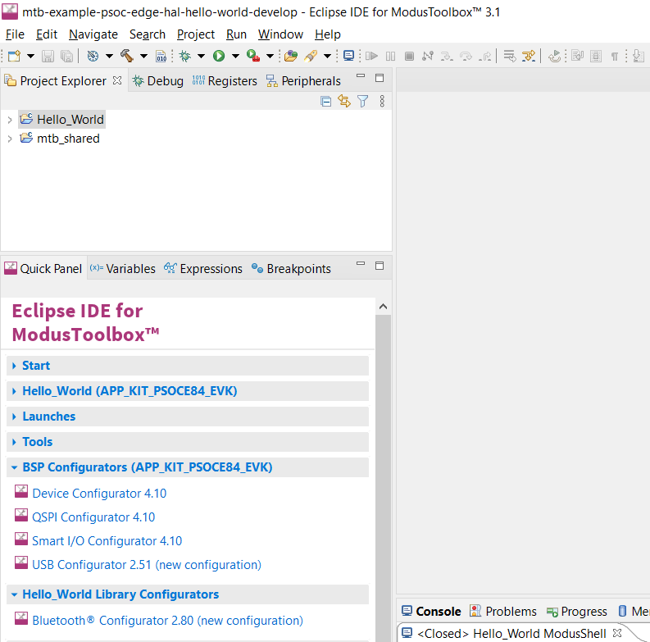
Configurators
Device Configurator
QSPI Configurator
Smart I/O Configurator
USB Configurator
Configurators
  Creates structures needed for peripherals
  used by PDL
  Not needed for applications using HAL
Notes:
(Will show actual tool)
Moving on to configurators
Modus Toolbox™ software provides configurators that make it easier to configure a hardware block. Some functionalities include
• Setting options and generating code to configure drivers
• Setting up connections such as pins and clocks for a peripheral
• Setting options and generating code to configure middleware
For PSOC™ Edge E84 MCU applications are supported by many configurators such as Device, ML, USB, QSPI Configurators, etc.
NOTE : Configurators make initial setup easier for hardware accessed using the PDL. The configurators create structures that the PDL requires. You don’t need to know the exact composition of each structure. If you use the HAL for a peripheral, it creates the necessary structures – called HAL objects - for you, so you should NOT use a configurator to set them up. HAL objects are accessible; after you initialize a peripheral with the HAL you can view and modify the object.
[Press Enter for animation] Quick panel list all configurators or Right click on project on select ModusToolbox™
option for list of configurators
Lets look at the configurators in detail

Slide 11
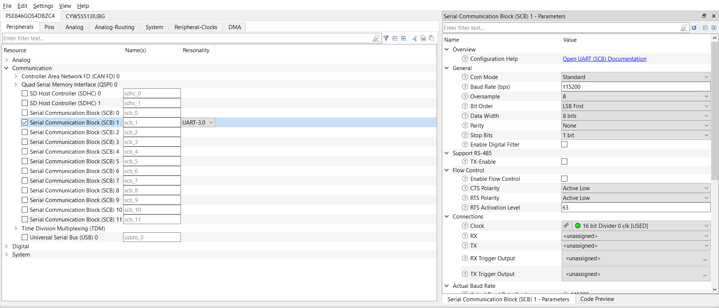
Device Configurator
Notes:
(Will show actual tool)
Device Configurator helps in setting up the system-level functions, pins, and basic peripherals like UART, Timer, PWM, etc.
The Device Configurator GUI contains menus, icons, tabs, and several panes used to configure MCU peripherals. Let’s look at a few important ones.
[Press Enter for animation] Peripherals tab: The Peripherals tab is where you enable various analog, digital, system, and communication peripherals for the device to include in your application.
[Press Enter for animation] By selecting the specific peripheral as shown here - “serial communication block (SCB) 1 with UART”, a parameter pane on the right-hand side shows up and contains all the parameters for the enabled resource.

Slide 12
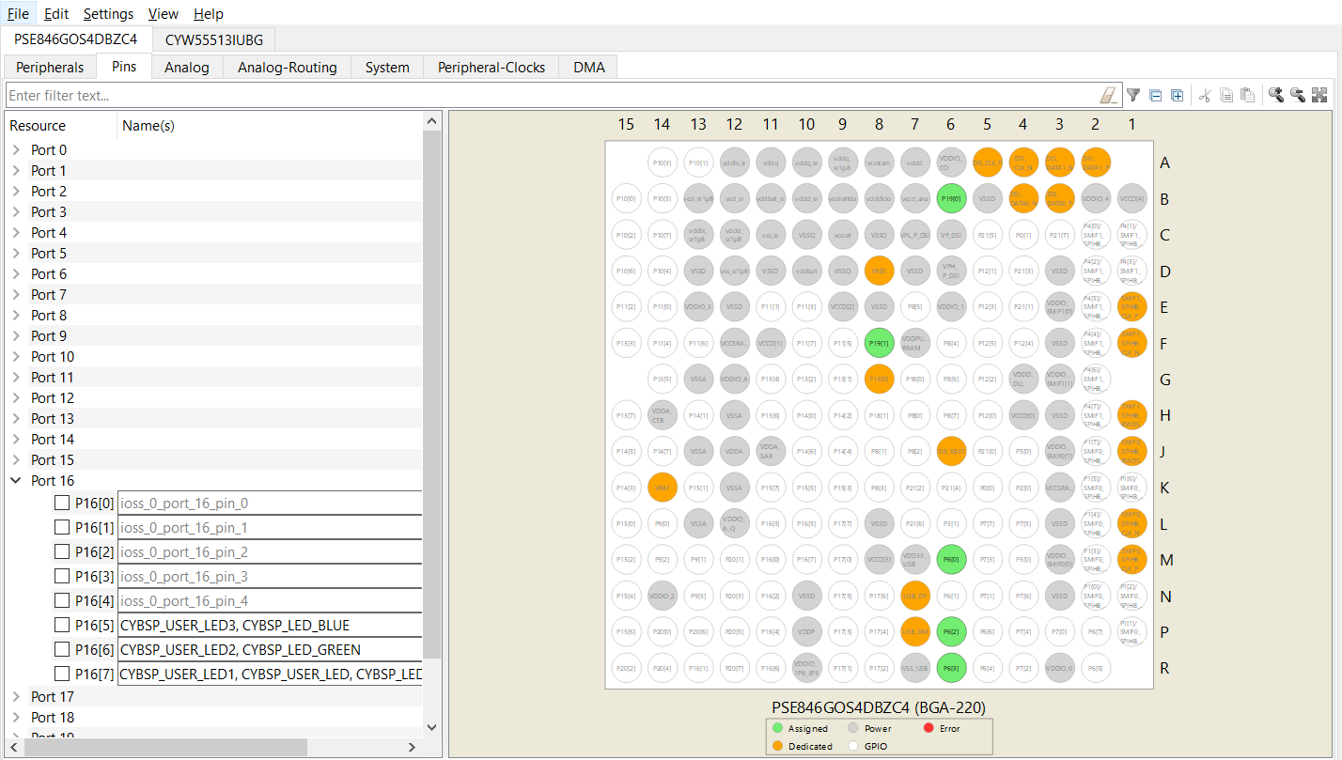
Device Configurator contd…
Notes:
(Will show actual tool)
[Press Enter for animation] The Pins tab is where you configure all the pin-related settings. All available pins are shown in an expandable tree, arranged by port number.
[Press Enter for animation] The interactive pin package diagram shows the different states of the pins; there is a legend on the diagram. You can enable/disable a pin by double-clicking it in the diagram.
Pin states are shown in different colors: ◼ White – GPIO ◼ Green – Assigned ◼ Grey – Power/ground pins ◼ Orange – Fixed function pins ◼ Red – Error state ◼ Semi-transparent – Indicates the hardware resource has been locked.

Slide 13
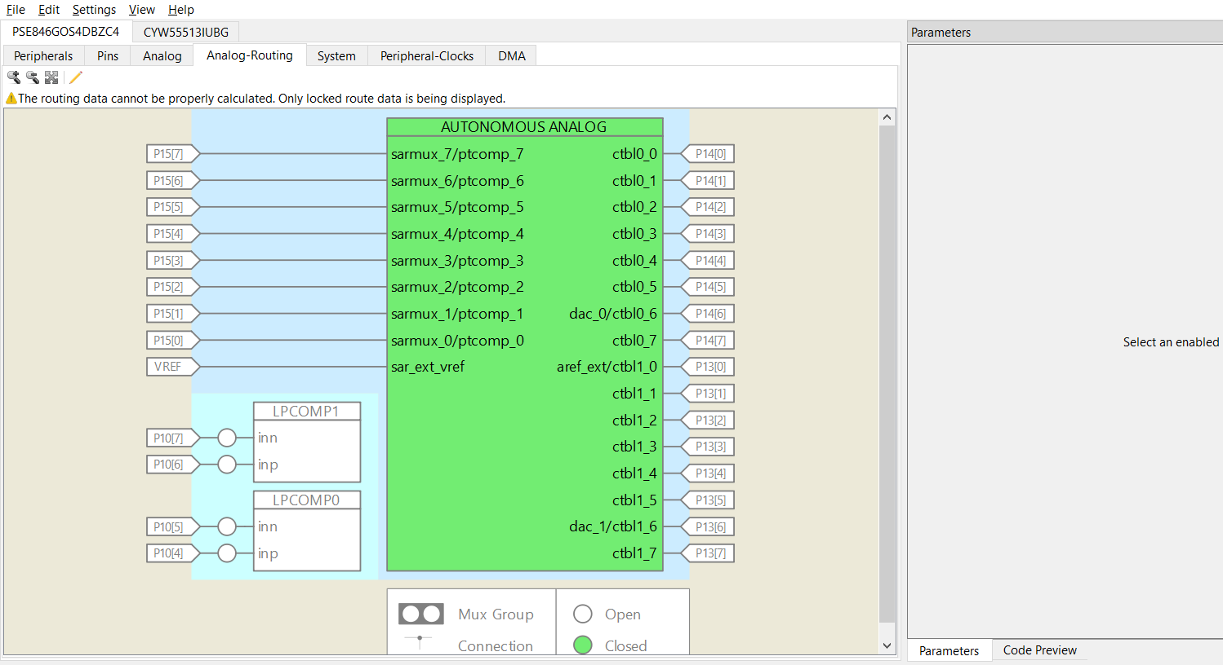
Device Configurator contd…
Notes:
(Will show actual tool)
[Press Enter for animation] The Analog and Analog-Routing tabs help configure the various analog resources in your application. Enabled resources are indicated in green.
The Analog Routing allows you to manually edit the routing of analog resources in your application. It also provides the ability to lock down all or some of the results.

Slide 14
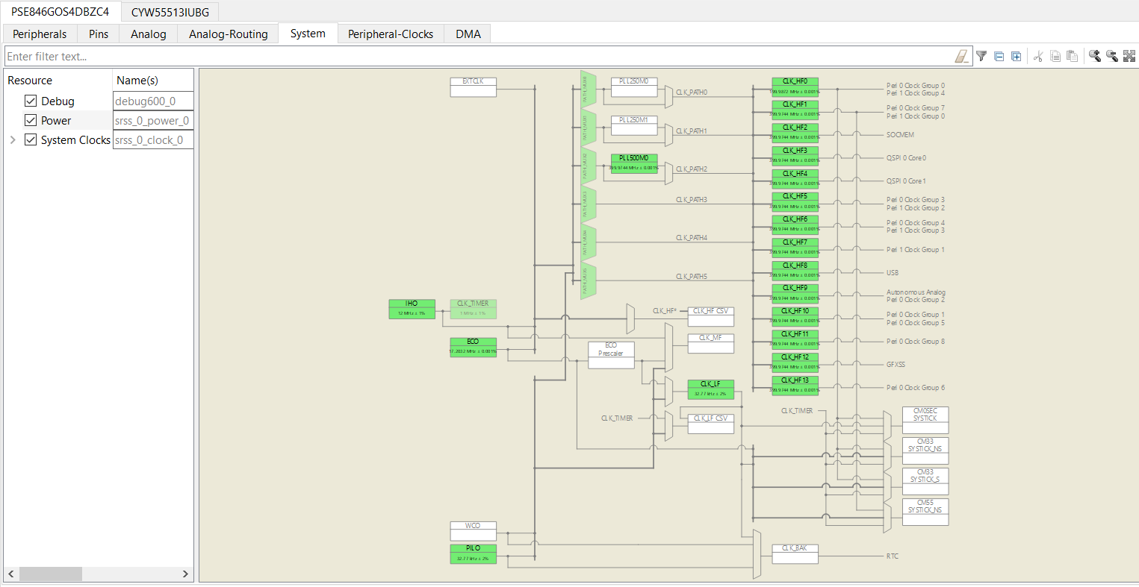
Device Configurator contd…
Notes:
(Will show actual tool)
[Press Enter for animation] The System tab provides access to system-level functions, such as system clocks, power management, and debug interfaces.
The interactive clock diagram shows all the system clocks and how they connect to each other. You can enable/disable a clock by double-clicking it in the diagram. Enabled clocks are green, disabled clocks are white, and clocks in error state are red

Slide 15
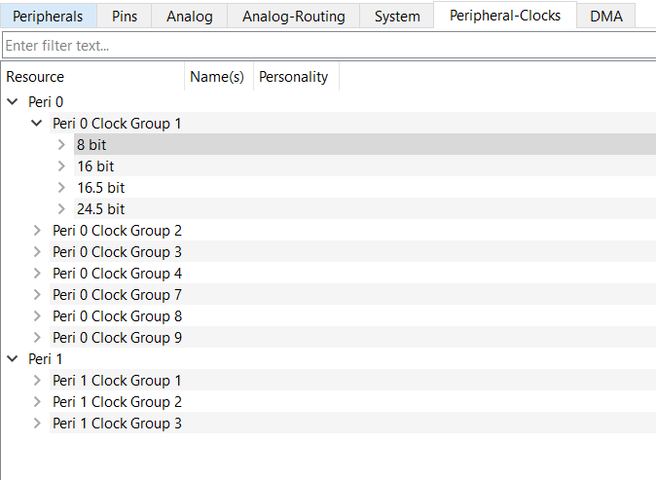
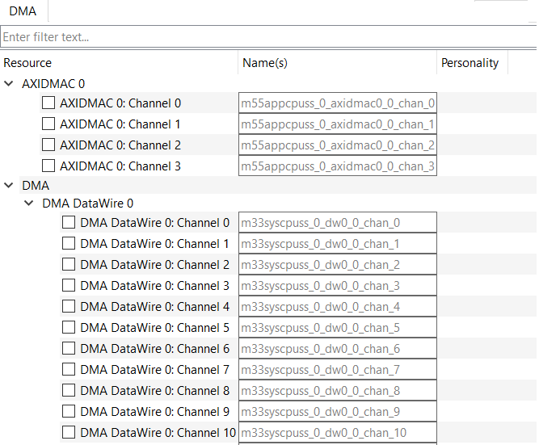
Device Configurator contd…
Notes:
(Will show actual tool)
[Press Enter for animation]
The Peripheral-Clocks tab lists all the clocks in a design used to drive the various peripherals.
[Press Enter for animation]
The DMA tab lists all the DMA resources in the design
The Device Configurator saves configuration information in a design.modus file, which contains all the required information about the device and the application. When you save changes, the Device Configurator generates/updates firmware in the BSP’s "GeneratedSource" folder

Slide 16
TrustZone Primer
Notes:
As seen in the E1 session, the CM33 core comes with TrustZone enabled. TrustZone Technology is a new technology from Arm that adds two additional states to the CPU namely Secure and Non-Secure on top of thread and handler states. This allows resources to be partitioned between Secure and Non-Secure states as shown in the figure. TrustZone represents the boundary within which the code can be trusted.
Due to these security states, the same resource like a physical memory can be accessed from a Secure aliased or a non-Secure aliased region based on the security setting. This allows resources to be isolated between the two states.

Slide 17
TrustZone Primer
Notes:
The allocation of security attributes is done using the Implementation Defined Attribution Unit or IDAU and Secure Attribution Unit or SAU. The IDAU sets the default security attributes for a region by design. The SAU is user configurable and can be set to Secure, Non-Secure or Non-Secure Callable. The security attribute of a memory region is the resultant of the combination of SAU and IDAU. The higher security level of the two takes precedence.
As seen in the figure, the physical memory is aliased into Secure and Non-Secure. If the top-half of the physical memory is set to NS using the attribution units, then that memory region can only be accessed from the NS alias and vice-versa.

Slide 18
TrustZone Primer
Notes:
In this illustration, the physical memory is divided into two distinct NS regions that are non-contiguous. Two entries of the SAU are assigned as NS to make the resultant of the IDAU and SAU as NS.
Since the number of SAU entries are just 8, it is beneficial to have contiguous memory regions marked as NS rather than non-contiguous. This way SAU entries can be optimized.

Slide 19
TrustZone Primer
Notes:
The SAU and IDAU filter the access at the CPU level. To filter accesses at the memory level Memory Protection Controllers or MPCs are used. MPCs allows finer control over security accesses by allowing you to configure the protection context, read/write access and security attribute. For example, for RRAM, the MPCs allow granular control of 4KB blocks.
Similarly, the Peripheral Protection Controller (PPCs) control the security attributes for peripheral regions.

Slide 20
TrustZone Primer
Notes:
The MPCs contain a Look Up Table (LUT) for the security attributes for each block per PC. This allows you to control the accesses for each of the PCs for a particular block of memory.

Slide 21
TrustZone Primer
Notes:
This slide shows how the transactions occur and how accesses get restricted or allowed.
If the processor is in Secure State, the resultant of SAU and IDAU which is set to Secure mark the transaction as being Secure and allow it to go through. At the memory level, since the MPC is marked as Secure, the transaction goes through and access is allowed.
In the second example, the processor in the non-secure state is blocked access if the SAU+IDAU is set to Secure.
Similarly, if the memory is marked as NS using the MPC, the access is blocked for a secure transaction.
The transaction only goes through if the security profile between the IDAU + SAU and MPC remains the same.

Slide 22
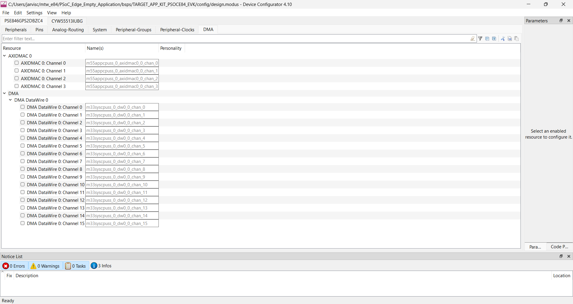
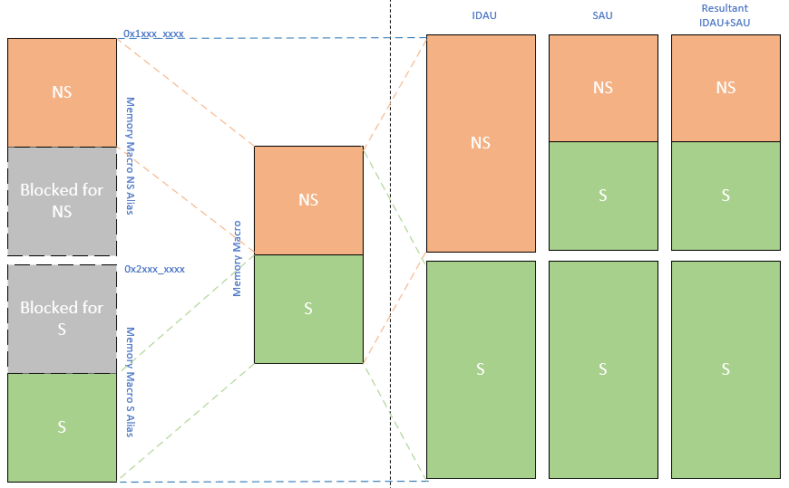
Access Control tab (New)
Access Control
Note: Not yet available. Subject to change.
Notes:
The Access Control tab is a new addition to the Device Configurator. This tab will allow users to setup the protection units and security attributes for memory regions using an intuitive graphical interface. This way access to the memory regions for different bus masters can be controlled.
The visualizations are just an example and subject to change.

Slide 23
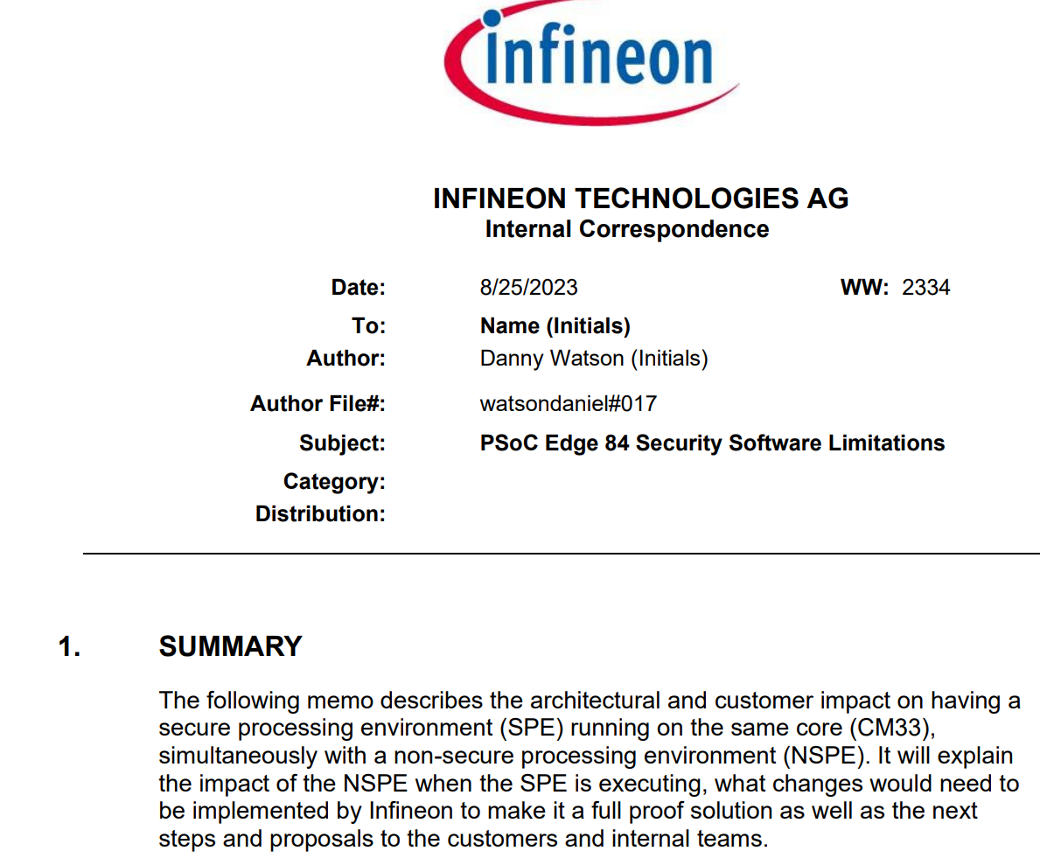
PSOC Edge 84 Security Software Limitations
Notes:
The following memo describes the architectural and customer impact on having a secure processing environment (SPE) running on the same core (CM33), simultaneously with a non-secure processing environment (NSPE). It will explain the impact of the NSPE when the SPE is executing,

Slide 24
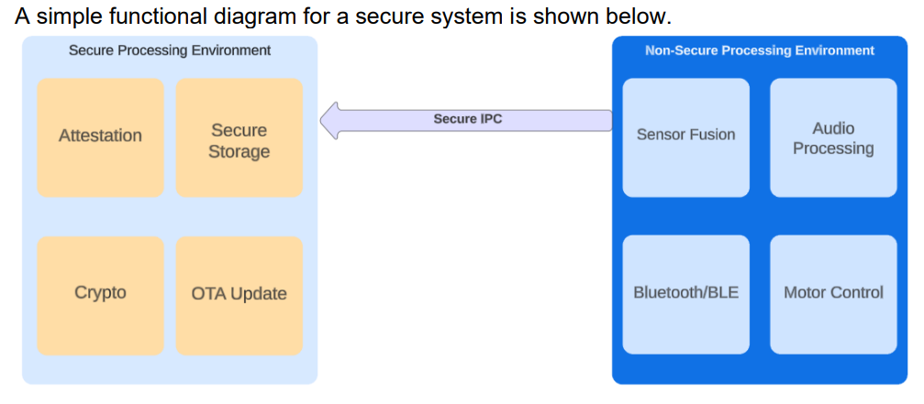
PSOC Edge 84 Security Software Limitations
https://doc.cypress.com/dms3/memodetails?memoNum=watsondaniel-21&empId=143340
Notes:
To understand the consequences of this, here are some examples of the NSPE needing timing related priority to ensure the functions of the product: • Bluetooth timing requirements of the stack • Collecting sensor data from the DMA and interrupts • Processing voice input ensuring samples aren’t dropped. • Performing motor control functions
What this ultimately means is when context is switched to the SPE, context cannot be passed back to the NSPE until the SPE runs to completion. The stock TF-M implementation does not have any isolated timing requirements, however, when NSPE requests a service from the SPE within the CM33, the NSPE CM33 will be blocked until completion resulting in a synchronous blocking call to the SPE.
For More detail refer the MEMO

Slide 25
Security Domain
Notes:
A security domain is a software abstraction that allows the grouping of resources into domains to isolate accesses between one another.
At isolation level 1, there’s two domains, the Secure Processing Environment (SPE) and Non-Secure Processing Environment (NSPE). The SPE represents in the Secure CM33 and the NSPE represents both the Non-Secure CM33 and Non-Secure CM55.
At isolation level 2, we drill down further into the SPE to isolate the Platform Root Of Trust and Application Root of Trust.
At isolation level 3, we isolate all the secure services that are offered as part of the Platform RoT and Application RoT.

Slide 26
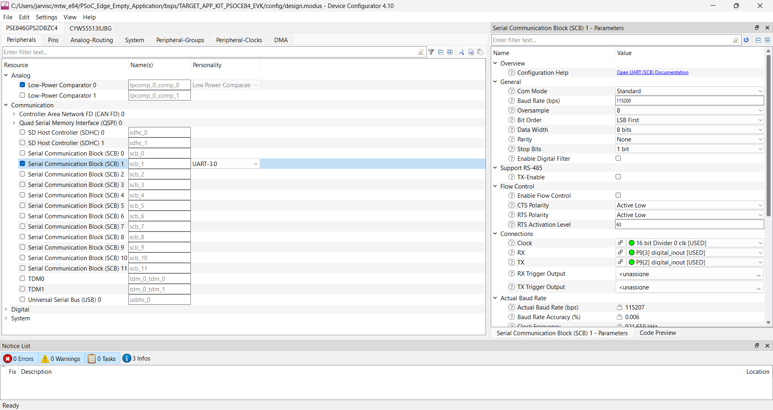
Security Domain Assignment
Security Domain
NSPE Domain
NSPE Domain
NSPE Domain
NSPE Domain
NSPE Domain
NSPE Domain
SPE Domain
NSPE Domain
NSPE Domain
SPE Domain
NSPE Domain
NSPE Domain
NSPE Domain
NSPE Domain
NSPE Domain
NSPE Domain
Notes:
All the resources can be assigned to a security domain in the device configurator to isolate them from one another. More on security domains will be covered in a later slide.

Slide 27
Linker Script – Memory Map
RRAM (256 KB + 172 KB (A0 silicon) )
Start address
CBUS S / CBUS NS
SAHB S / SAHB NS
L1 Boot
Header
CM 33 S
Header
User CM33 NS / CM55 App
Additional Unused space for L2 Part (For A0 silicon can be used for CM33 NS / CM55 APP)
60 KB
Memory Regions
RRAM | CBUS S | SAHB S | CBUS NS | SAHB NS
Start Address | 12000000 | 32000000 | 2000000 | 22000000
End Address | 12040000 | 32040000 | 2040000 | 22040000
108 KB
88 KB
END address
CBUS S / CBUS NS
SAHB S / SAHB NS
172 KB
CM55 : CBUS NS
Note : 1. Default configuration , can be changed by customer as per their requirement except L1 boot
2. These memory configurations are proposed ; Work in Progress.
Notes:
PSOC Edge E84 comes with wide variety of memory options. All the Infineon code examples contains a set of default linker scripts.
A linker scripts can be modified by user as per their needs.
By considering the default configuration, lets look at how the memories are being used.
First one on the list is RRAM, resistive random access memory with 256 KB divided into particular section like L1 boot , CM33 secure application and CM33 Non secure or for CM55 application + we have 172 KB available in A0 silicon which can be used for CM33 Non secure or for CM55 application

Slide 28
External Flash XIP0 (16 MB)
Start address
CBUS S / CBUS NS
SAHB S / SAHB NS
Protected Storage
Header
CM33 L2 boot (1MB)+ CM33 S (1.25MB) Code + Trailer (.25)
Header
CM33 NS Code + Trailer (.25)
Header
CM55 Code + Trailer (.25)
Header
CM33 S Secondary Slot
Header
CM33 NS Secondary Slot
Header
CM55 Secondary Slot
SE-RT Service Update (L4 Part only)
Unused
1 MB
2.25 MB
2.25 MB
3.25 MB
Memory Regions
XIP 0 | CBUS S | SAHB S | CBUS NS | SAHB NS
Start Address | 18000000 | 70000000 | 800000 | 60000000
End Address | 19000000 | 71000000 | 1800000 | 61000000
1.25 MB
2.25 MB
CM55 : SAHB NS
3.25 MB
END address
CBUS S / CBUS NS
SAHB S / SAHB NS
256 KB
Note : 1. XIP1 is unused
2. These memory configurations are proposed ; Work in Progress
Notes:
PSOC Edge kit has multiple option for external flash.
PSOC Edge supports 2 external flash namely XIP0 and XIP1
This slide shows the default memory map for External flash XIP0 , Make a note XIP1 is unused.

Slide 29
SRAM0 (512 KB)
L1 Boot
CM 33 S
User CM33 NS
Start address
CBUS S / CBUS NS
SAHB S / SAHB NS
4 KB
Memory Regions
SRAM0 | CBUS S | SAHB S | CBUS NS | SAHB NS
Start Address | 14000000 | 34000000 | 4000000 | 24000000
End Address | 14080000 | 34080000 | 4080000 | 24080000
336 KB
172 KB
END address
CBUS S / CBUS NS
SAHB S / SAHB NS
CM55 : SAHB NS
Note : 1. Default configuration , can be changed by customer as per their requirement except L1 boot
2. These memory configurations are proposed ; Work in Progress
Notes:
We have 2 SRAM namely SRAM0 and SRAM1
This slide shows the default memory map for SRAM0, 512 KB memory has been divided into mainly L1 boot, CM33 Secure and CM33 Non secure application

Slide 30
SRAM1 (512 KB)
Start address
CBUS S / CBUS NS
SAHB S / SAHB NS
CM 55 NS
Shared Memory
504 KB
Memory Regions
SRAM1 | CBUS S | SAHB S | CBUS NS | SAHB NS
Start Address | 14080000 | 34080000 | 40080000 | 24080000
End Address | 14100000 | 34100000 | 40100000 | 24100000
8 KB
END address
CBUS S / CBUS NS
SAHB S / SAHB NS
CM55 : SAHB NS
Note : These memory configurations are proposed ; Work in Progress
Notes:
This slide shows the default memory map for SRAM1, 512 KB memory has been divided into mainly CM55 Non Secure application and shared memory

Slide 31
System SRAM or SoCMEM (~5 MB)
CM55 NS
Unused
Shared Memory
Start address
CBUS S / CBUS NS
SAHB S / SAHB NS
1 MB
Memory Regions
SoCMem | CBUS S | SAHB S | CBUS NS | SAHB NS
Start Address | 16000000 | 36000000 | 6000000 | 26000000
End Address | 16500000 | 36500000 | 6500000 | 26500000
1 MB
END address
CBUS S / CBUS NS
SAHB S / SAHB NS
CM55 : SAHB NS
Note : These memory configurations are proposed ; Work in Progress
Notes:
Approx 5 MB System SRAM, also known as "system-on-chip memory" (SoCMEM). This memory is organized in ten partitions of 512‑KB each, with retention of individual partitions. It can be accessed from either the M55 or the M33 domain, with bus arbitration
This slide shows the default memory map for SoCMEM.

Slide 32
DTCM & ITCM
DTCM
ITCM
Start address
0x20000000
Start address
0x0
CM55
CM55
256 KB
256 KB
END address
0x20040000
END address
0x40000
Note : These memory configurations are proposed ; Work in Progress
Notes:
This slide shows the default memory map for DTCM & ITCM, 256 KB memory which can be used for CM55

Slide 33
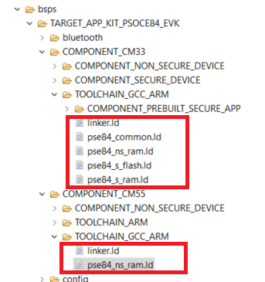
Linker Scripts
Seven linker scripts
  3 Ram and 3 Flash (secure, non secure)
  1 common
PSOC Edge E84 Applications
RAM (Internal Use)
Flash (default for customer)
Notes:
PSOC Edge code examples uses seven linker scripts.
3 RAM configuration for CMM33 secure , CM33 Non secure and CM55 application
3 Flash configuration for CMM33 secure , CM33 Non secure and CM55 application
And one common linker script which has all the memory section described
Default linker scripts used in most of our code examples are based of flash.

Slide 34
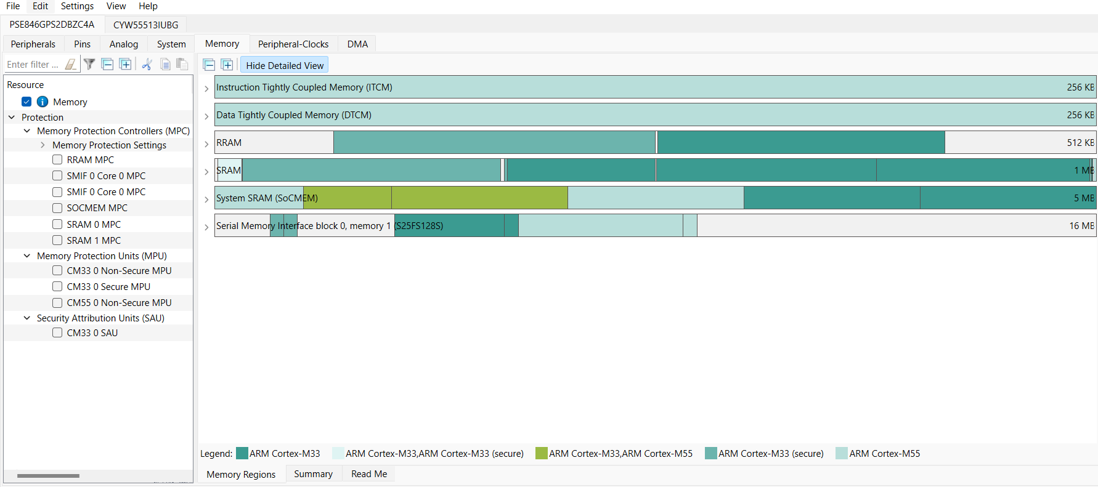
Memory tab (New)
Notes:
The Memory tab is a new addition to the device configurator and allows you to place code and data on different memories and get the maximum performance and lowest power needed for your application. The output of this tab will be a linker script that you can directly use in your application.
Note : Memory configurator is in development stage. Full pledge version will be available in upcoming version

Slide 35
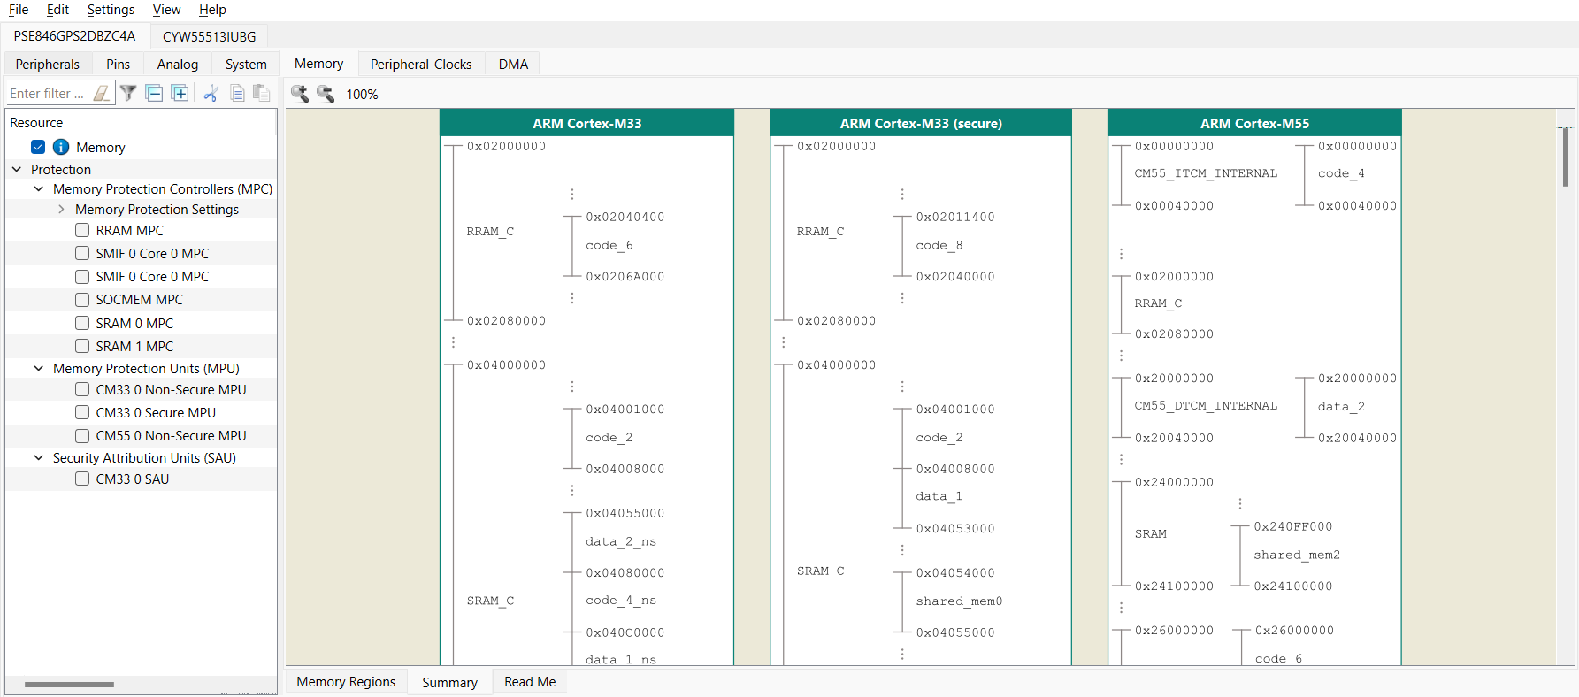
Memory tab (New)
Note: Not yet available. Subject to change.
Notes:
The memory tab will also provide a high-level visualization of where the different projects are stored and how much size they occupy. All visualizations are just an example and subject to change.

Slide 36
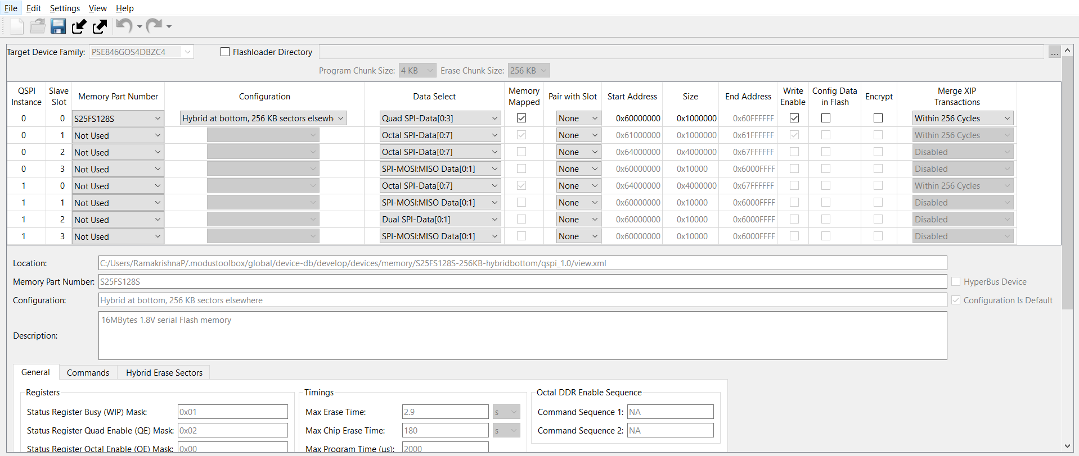
QSPI Configurator
Notes:
(Will show actual tool)
Now let’s look at the QSPI Configurator
The Quad Serial Peripheral Interface (QSPI) Configurator helps configure external memories and generate code for easy integration into the application. You can open or create memory configuration files, configure memory slots, and generate code for your application.
The CAT1D category of devices where PSOC Edge E84 MCUs fall under, supports extending the default RAM and flash with external memory chips of the following types: flash, non-volatile FRAM, or RAM.
The QSPI Configurator holds information about the set of default memory parts. However, if your specific memory part is not present, you can create a new one.
The QSPI Configurator saves configuration information in a .cyqspi file, which contains all the required information about the device and the application. When you save changes, the QSPI Configurator generates/updates firmware in the BSP’s "GeneratedSource" folder.

Slide 37
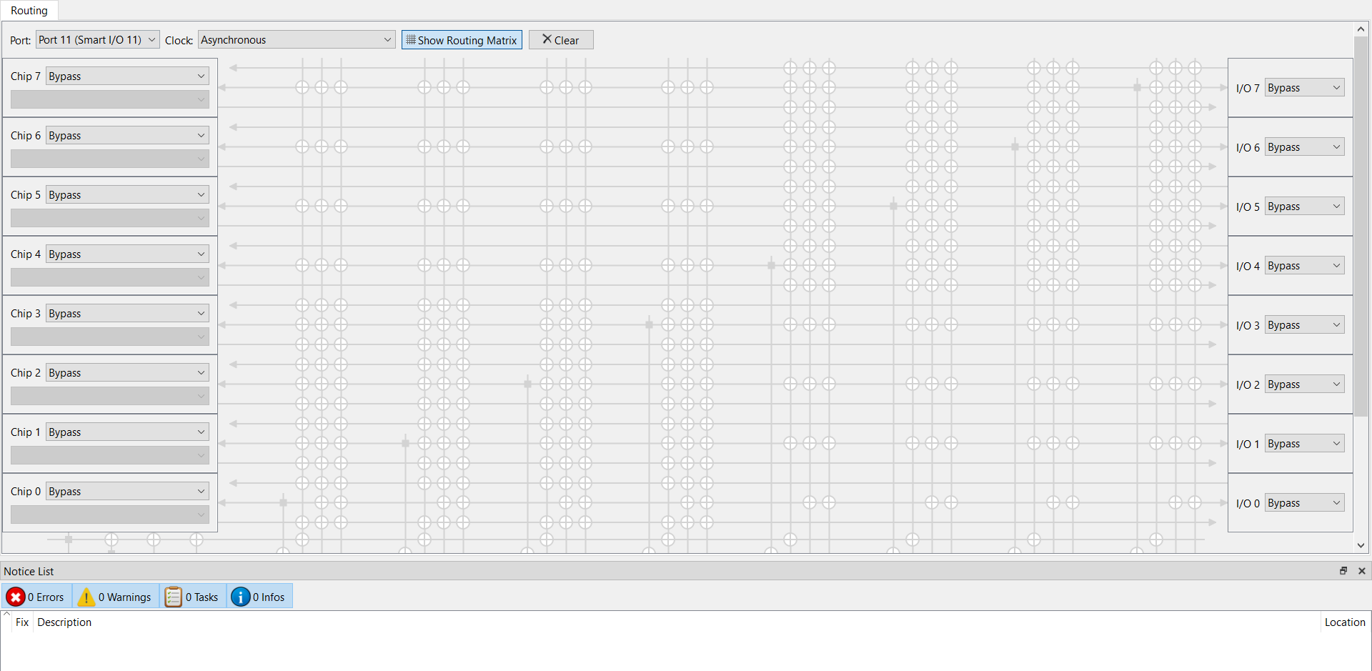
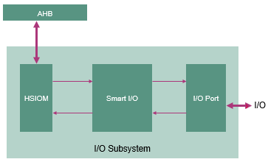
SMART I/O Configurator
Notes:
(Will show actual tool – need to leverage overlay)
Moving further, we have the SMART I/O Configurator
The Smart I/O Configurator is part of a collection of tools included in the ModusToolbox software. It provides a GUI to configure the Smart I/O.
The Smart I/O block adds programmable logic to an I/O port.
[Press Enter for animation]
It is positioned in the signal path between the highspeed I/O matrix (HSIOM) and the I/O port. The HSIOM multiplexes the output signals from fixed-function peripherals and the CPU to a specific port pin and vice-versa. The Smart I/O block is placed on this signal path, acting as a bridge that can process signals between port pins and the HSIOM.
There are several areas in the GUI to configure signals: Chip, I/O, Data Unit, and LUT. Inputs to the chip from the I/O port can be logically operated upon before being routed to the peripheral blocks or internal connections of the chip. Likewise, outputs from the peripheral blocks or internal connections of the chip can be logically operated upon before being routed to the I/O port.

Slide 38
Application Booting sequence
Boot starts from Secured Enclave as the Root of Trust
Off-the-shelf extended boot software
  Boot from RRAM or external flash
  Alternate serial interface for recovery boot
  SRAM loading for enhanced security
Optional MCUboot based Edge Protect Bootloader
One time revocable OEM RoT Key
Notes:
The PSOC™ Edge E84 secured boot process starts with BOOT_ROM. As a root-of-trust (RoT), it entails the next
level software authentication through the public key cryptography to ensure that only authorized software is
loaded and executed on the device
Secured enclave boot
The PSOC™ Edge E84 secured enclave is based on the lock-step Cortex® -M0+ CPU, coupled with dedicated local
ROM, SRAM, and islands of replication of hardware cryptographic accelerators. The secured enclave has
exclusive access to the sensitive data on the device. It is isolated from the rest of the system and provides a
secured environment for secure boot and PSA-compliant cryptographic services. APPCPUSS and SYSCPUSS can
communicate with the secured enclave through a tightly-controlled IPC mechanism. The secure enclave
decides what information should be shared in response to an IPC request.
The secured enclave provides multi-stage booting through immutable ROM_BOOT and RRAM_BOOT.
Together, BOOT_ROM and RRAM_BOOT offer the following functionality.
• Implements a hardware RoT in protection-context 0 and provides an immutable trust anchor based on
authorization from Infineon
• Applies the trims and performs authentication of Extended Boot and launches them on successful
authentication
• Authenticates and launches the SE RAMApps (Secured Enclave RAMApps) and enables the device
provisioning
• Facilitates “secured debug” by enforcing access restrictions on the debug access port (SWD/JTAG)
• Provides PSA-compliant Crypto services for Application CPUs
Extended Boot
Extended Boot is the first code executed by the CM33 CPU of PSOC™ Edge E84. The secured enclave boot
software authenticates the Extended Boot image on RRAM, and launches it if authentication is successful.
Devices are shipped out from Infineon in development lifecycles. In this lifecycles, Extended Boot is pre-programmed into
the device, but not locked down.
The stock version of the Extended Boot offers the serial interface (I2C, SPI,
UART and USB) capability. Infineon also releases a version of Extended Boot without alternate serial
interfaces, which reduces the footprint on RRAM. As long as the device is in development lifecycles, Extended Boot
can be re-programmed via the secured enclave RAMApps provided by Infineon. Extended Boot gets locked
down when device transitions to production lifecycle. Note that since Secured Enclave can only authenticate
Infineon-signed versions of Extended Boot , it is mandatory to use Infineon-released versions
Extended Boot launches CM33 Secure project present in RRAM from a fixed location, which then configures external QSPI flash in XIP mode and launches CM33 Non-Secure application. Additionally CM33 Non-Secure application enables CM55 CPU and launches the CM55 application in external flash.

Slide 39
Device lifecycle and provisioning
Development
  Shipped from Infineon
  Provision with OEM certificate and policy
  For OEM development; until production
Production
  One-time provisioning with “Production” certificate
  Re-provisioning if allowed by policy
RMA
  Transition from Development or Production
  Performed by Infineon signed SE Service Application
  Devices in RMA mode can be shipped to Infineon for field failure analysis
Notes:
Development :
PSOC Edge MCU is shipped from Infineon factory in the “Development” lifecycle. OEM can extend the ownership of the device by provisioning the device with OEM certificate.
Provisioning process installs the OEM keys; debug, boot, and system configuration policies; as well as the extended boot software
The development lifecycle is recommended for all development activity until the device is ready to go for production
In this lifecycle OEM can enable or disable the secure boot.
Production :
OEM can transition the device from “Development” to “Production” by provisioning the device with a OEM “Production certificate”.
Re-provisioning is possible if allowed by the policy
Secure boot is always enabled in this lifecycle
Most device assets are “frozen” in the production lifecycle and cannot be changed unless allowed by the re-provisioning policy.
Note: OEM certificate for provisioning is required to be signed by Infineon. Edge Protect Signing service can be availed to sign the certificate.
RMA :
Transition to RMA is possible from development and production lifecycle
It is performed by an SE Service application, which is provided by Infineon
Device in RMA mode can be shipped to Infineon for failure analysis

Slide 40
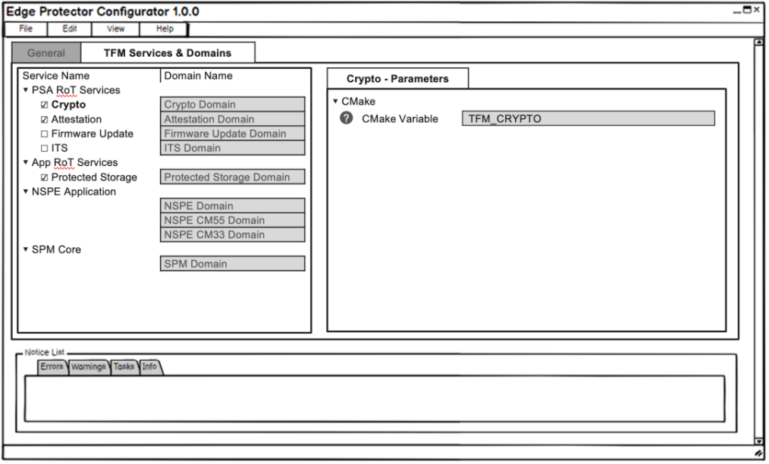
Edge Protect Configurator

Slide 41
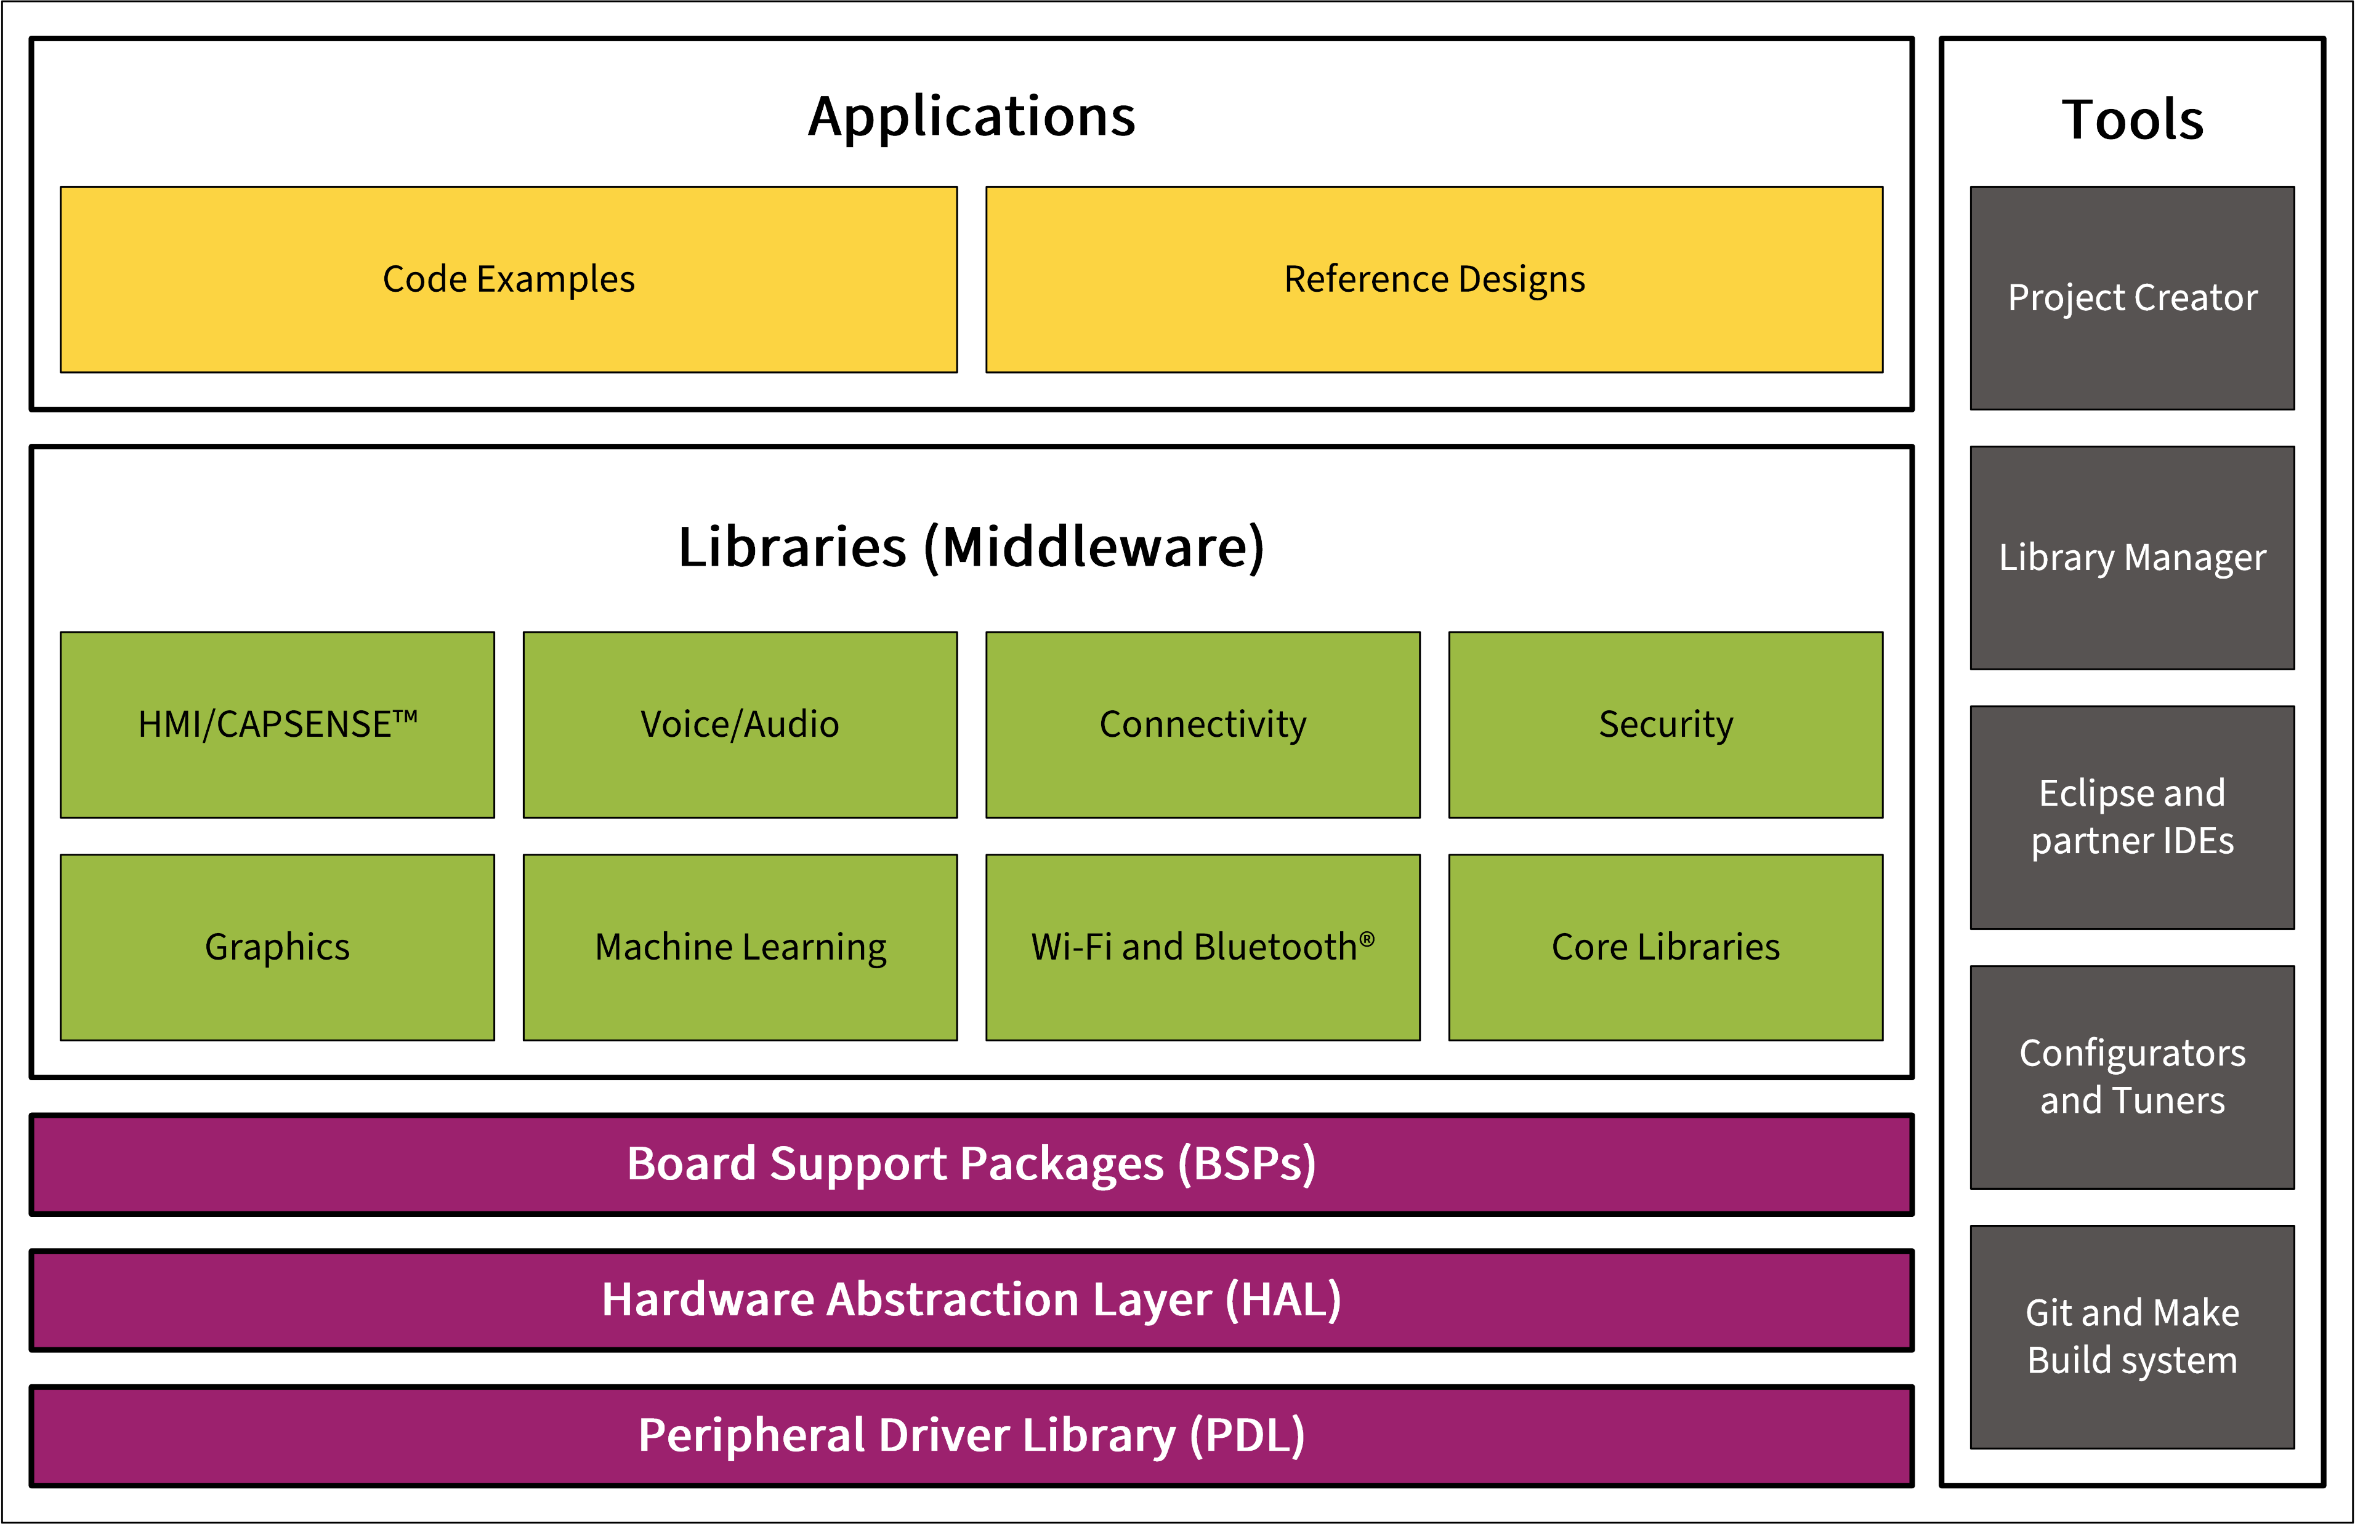
Firmware/application development : Software Resources
Peripheral Driver Library (PDL)
  Set of low-level APIs
  Hardware specific so less portable
Notes:
Let’s now look at the available Software resources
The software stack in this figure illustrates the different components that makeup ModusToolbox.
[Press Enter for animation] The PDL contains a set of low-level APIs to control hardware peripherals such as UART and SPI. The interfaces are usually specific to a particular device. Since the PDL interacts with the hardware at a lower level it is less portable between devices.

Slide 42
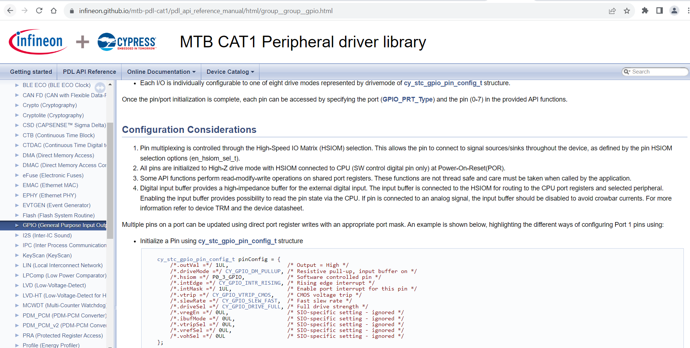
Firmware/application development : Software Resources
https://infineon.github.io/mtb-pdl-cat1/pdl_api_reference_manual/html/index.html
Notes:
To understand or to learn about the PDL APIs, refer to the PDL documentation
[Press Enter for animation] Here is the link for PDL documentation,

Slide 43
Firmware/application development : Software Resources
Hardware Abstraction Layer (HAL)
  High-level APIs built on top of PDL
  Hardware generic, so more portable
  HAL is useful for:
    Changing pin assignments for peripherals in
    the same MCU
    Porting to another MCU in the same
    product line
    Porting to another MCU in a different
    product line
Notes:
Moving Further on HAL (Hardware Abstraction Layer)
[Press Enter for animation] The HAL contains a set of high-level APIs to control the hardware peripherals. It is a high-level interface to the hardware that allows many common functions to be done quickly and easily. The interfaces are more portable than PDL. This allows the same code to be used across different devices in the same product line, or even on different product lines that may have a radically different architecture.

Slide 44
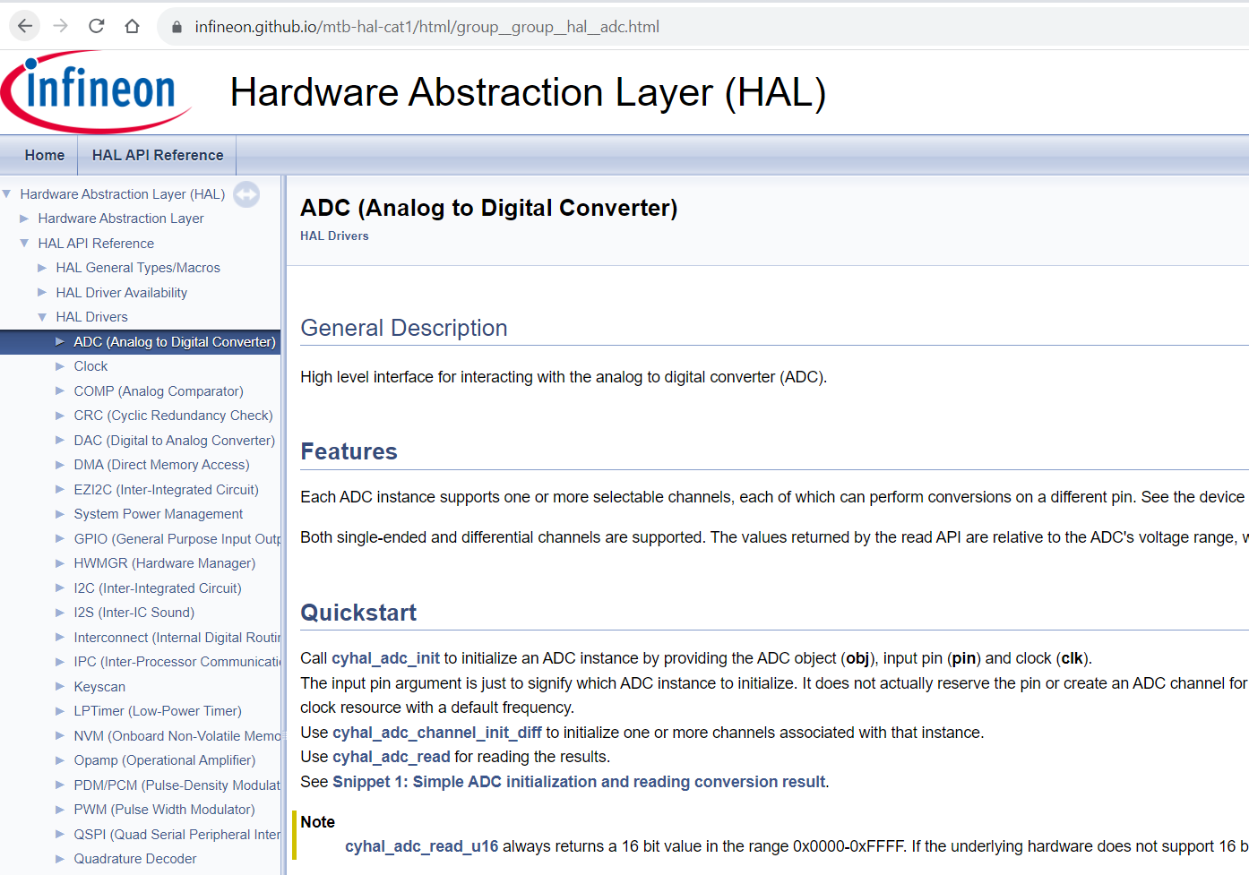
Firmware/application development : Software Resources
https://infineon.github.io/mtb-hal-cat1/html/index.html
Notes:
To understand or to learn about the HAL API’s, refer to the HAL documentation
[Press Enter for animation] Here is the link for it.

Slide 45
Firmware/application development :Software Resources
Applications
  Code examples
  Reference Designs
Middleware Libraries
Notes:
[Press Enter for animation] At the application level we provide code examples and reference designs that help you develop applications.
[Press Enter for animation] Next, the middleware provides an extensive set of libraries for different solutions including graphics, touch sensing, machine learning, USB, and security. They can be added to your application using the Library manager.

Slide 46
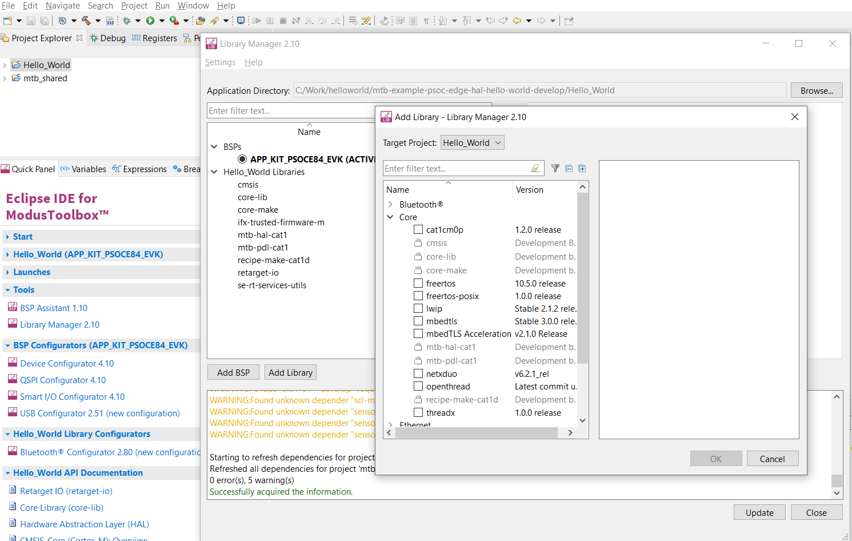
FreeRTOS support with ModusToolbox™
Notes:
(Will show actual tool)
Moving on lets look at how to add Freertos to your application
Adding native FreeRTOS support to a ModusToolbox™ application project is like adding any middleware library.
You can include the FreeRTOS middleware in your application by using the Library Manager.
If using the Eclipse IDE, select the application and
[Press Enter for animation] Click the Library Manager link in the Quick Panel.
[Press Enter for animation] Click Add Library and
[Press Enter for animation] Select freertos from the Core dialog.
[Press Enter for animation] Click OK and
[Press Enter for animation] Update

Slide 47
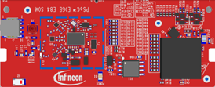

PSOC™ Edge E84 MCU development kit – Top View
Power LED
Ethernet RJ45; (DNI)
M.2 Radio Socket
I2S I/Os
(DNI)
mikroBUS socket (Click); (DNI)
I/O Headers
(DNI)
Arduino UNO socket
KitProg (P5LP)
KitProg USB
KitProg Mode Select Button
Sheild2GO socket;
(DNI)
Reset Button
ETM Header
Alt. Serial Interface;
(DNI)
SWD/JTAG Header (M33/M55/U55)
Proximity
Speaker
USB Host
IMU (Accelerometer + Gyro) &
Magnetometer
M.2 Memory Socket
Boot Select
Power Selection
Power Monitoring
CapSense Slider and Buttons
USB Device
DC Power Socket
User Button
*DNI – Do not insert / load
Processor SoM socket
Potentiometer
User Button
Thermistor
User LED (x3)
Notes:
Presenter will explain the features available in the board showing the board to the attendees

Slide 48
PSOC™ Edge E84 MCU development kit – Back View
DMIC
Headphone Jack (DNI)
DMIC
SD Card Socket
10” Display Touchpad connector
AMIC
AMIC
10” MIPI-DSI Display connector
MIPI-DSI R-Pi Display connector
Notes:
Presenter will explain the features available in the board showing the board to the attendees

Slide 49
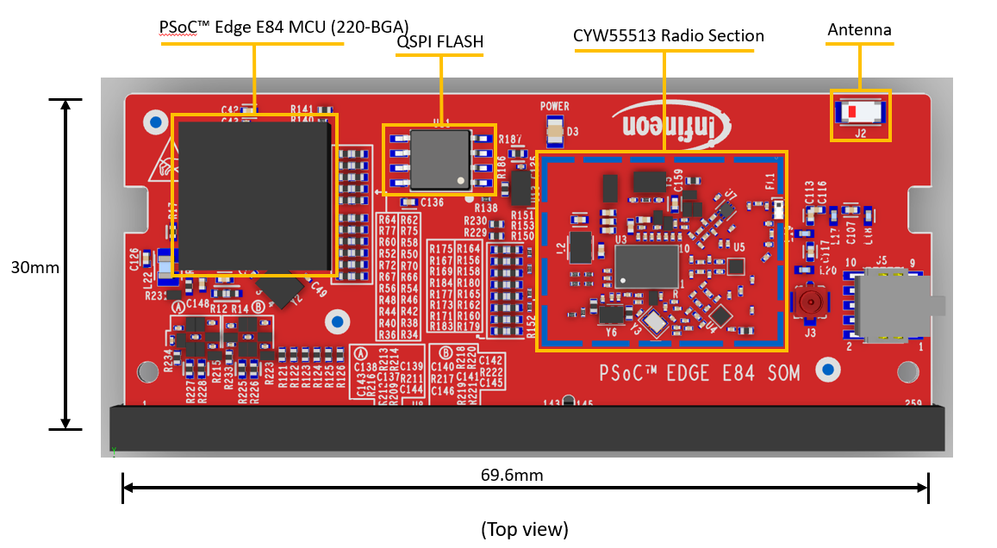
PSOC™ Edge E84 MCU SOM – Top View
Notes:
Presenter will explain the features available in the board showing the board to the attendees

Slide 50
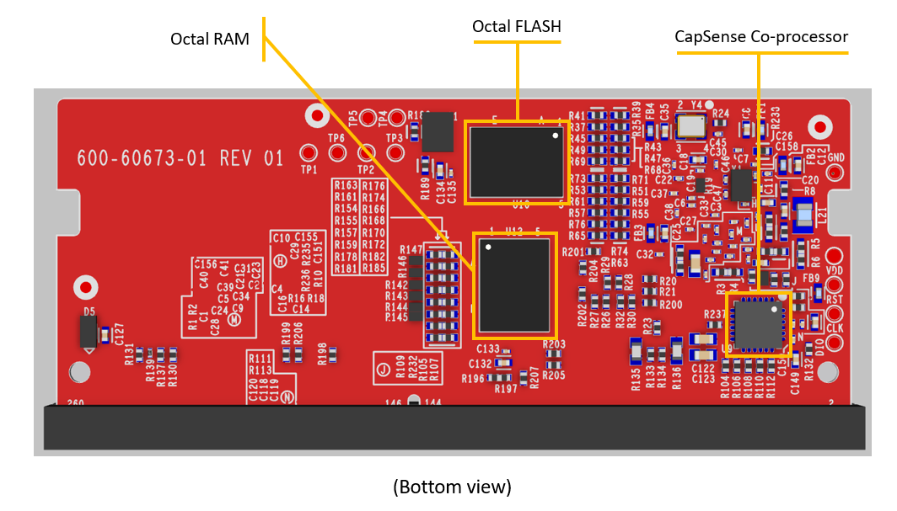
PSOC™ Edge E84 MCU SOM – Bottom View
Notes:
Presenter will explain the features available in the board showing the board to the attendees

Slide 51
Programming/debugging
  Programming and Debugging PSOC™ Edge E84 MCU
    Comes with a KitProg3 onboard programmer and debugger
    Supports CMSIS-DAP
    Supports OpenOCD using a GDB server and the J-Link debug probe
    Debug environment is IDE specific – refer to MTB documentation.
Notes:
Let’s now look at programming and debugging
ModusToolbox supports programming the device and debugging your code.
The PSOC Edge development kit has a KitProg3 onboard programmer and debugger. It supports the Cortex Microcontroller Software Interface Standard - Debug Access Port or in short the CMSIS-DAP.
Programming and debugging are native to your chosen development environment. Infineon devices are supported in major program and development solutions such as J-Link and OpenOCD - Open On-Chip Debugger.
There are a few specifics to be aware of regarding Debugging with the Early Access Pack of PSOC Edge and ModusToolbox v3.1
Reference the Getting Started Guide for installation details (Python and Edge Protect Tools) and the Early Access Pack Release Notes for specific launch configuration details
Let’s see Debugging in action

Slide 52
Code Example #1:
Hello World

Slide 53
Description of Hello World + Blinky example
Algorithm flow :This PSOC™ Edge E84 Hello World Code example demonstrates
Notes:
Now, lets see the description of the Hello World + Blinky example
This PSOC™ Edge E84 Hello World Code example demonstrates
Step 1: Initialize UART, GPIO and Timer
Step 2: Initiate UART communication by
sending “Hello World” to Serial terminal
Step 3: Blink LED , On every 1 second timer interrupt
Step 4 : Wait for the user input from serial terminal
to pause or resume the led blinking
We will be using HAL (Hardware Abstraction Layer) for this code example

Slide 54
Flow chart
Notes:
Lets look at the flow chart
Presenter will explain the flow chart

Slide 55
Code Example #2:
IPC queues using HAL
Notes:
Lets look at our second code example PSOC™ Edge MCU: IPC queues using HAL
Here are the steps we follow to develop our PSOC™ Edge MCU: IPC queues using HAL

Slide 56
Overview of IPC
Supports 16 communication channels
Supports 16 interrupt structures
Inter processor communication methods
  Half-duplex with shared event handling
  Half-duplex with independent event handling
  Full-duplex communication
IPC is available in CPU active power mode only.
AHB5 slave
AHB5 Slave interface
SRSS
IPC Structure
ACQUIRE*
NOTIFY
RELEASE
DATA
STATUS
Interrupt Structure
NOTIFY
RELEASE
Interrupts
* MS field of the Acquire register width has been expanded to 8 bits
Notes:
Lets discuss on IPC
The PSOC Edge E84 Inter-Processor Communication module is designed to facilitate the exchange of signaling messages between CPUs. The Inter-Processor Communication (IPC) module plays an important role in enabling multiple processors to effectively communicate and synchronize their operations.
IPC module support for up to 16 communication channels and 16 interrupts, adding a significant degree of versatility and flexibility to the communication framework. The IPC module operates when the CPU is in the Active power mode, but it becomes inactive the Sleep and Deep Sleep CPU power modes.

Slide 57
Block Diagram of IPC HAL
Notes:
The communication between more than one thread (CPU or task) is supported using an IPC driver. It implements two common methods, typically available in RTOS environments for thread interactions:
Semaphore (binary): used to regulate accesses to shared resources between two or more threads or used for signaling between two tasks. This type of semaphore can assume only values 0 or 1. Any thread can take (value set to 1) or give (value set to 0) the semaphore.
Queue: used to send any type of data between the threads. The user can set the number of items in each queue and define the item size. It implements a FIFO mechanism in firmware.
The IPC HAL driver will be built on top of the IPC PDL driver. The primary purpose of the IPC HAL driver is to provide a consistent, easy to use, API for customers to quickly implement their multiple CPU requirements, and for middleware that requires code to run on multiple CPUs

Slide 58
Queues
Notes:
In this code example we will be using queues , so lets understand about queues
The IPC HAL queues are built on top of the IPC PDL basic driver. It requires one IPC channel and one interrupt (for each CPU).
One IPC channel can have multiple queues. Each queue has its own memory pool, allocated by either CPU and placed in the shared memory. Any CPU can write and read from the queue. The same IPC channel can host more than one queue, so every access requires to indicate the IPC channel and a queue number
Each queue number structure maps to one queue pool memory. It also has information about how many items in the queue and where to read/write. The queue implements a FIFO in firmware.
The IPC Queue HAL driver setup the internal IPC interrupt. An interrupt shall occur every time the other CPU writes/read to/from the queue or reset it.
Note that when an action occurs, the IPC interrupt might trigger on both CPUs. It depends if any queue that belongs to the IPC channel has any enable event

Slide 59
IPC HAL (Hardware Abstraction Layer)
Feature | API Functions
Binary semaphore | cyhal_ipc_semaphore_init cyhal_ipc_semaphore_free cyhal_ipc_semaphore_take cyhal_ipc_semaphore_give
Message queue | cyhal_ipc_queue_init cyhal_ipc_queue_free cyhal_ipc_queue_get_handle cyhal_ipc_queue_register_callback cyhal_ipc_queue_enable_event cyhal_ipc_queue_put cyhal_ipc_queue_get cyhal_ipc_queue_count cyhal_ipc_queue_reset
Notes:
Here are the IPC Hardware abstraction layer APIs for binary semaphores and message queues

Slide 60
Description of PSOC™ Edge MCU: IPC queues using HAL
Both cores will be in sleep mode
CM33 : MCWDT wakes the system
CM55: Button press wakes the system
Shared Memory
MSG Queue
CMD Queue
CM55
CM33
Step 1 : Initialize HAL IPC Queues
Enable CM55 CPU
Step 2 : Initialize CM55 system
Step 3 :Add CMD_INIT to command queue
Step 4 : Initialize Watchdog timer
Step 7 : Enable Watchdog and crypto
Step 6 :Add CMD_START to command queue
Step 5 : 1st button press
Step 8 : if wdt_flag is set , generate random number and add to message queue
Step 9 :Add random number to message queue
Step 10 : if message queue contains Random number print on serial terminal
Step 13 : Disable Watchdog and crypto
Step 12 :Add CMD_STOP to command queue
Step 11 : 2nd button press
Notes:
Now, lets discuss on description of PSOC™ Edge MCU: IPC queues using HAL
In this code example, the CM55 CPU is the primary CPU, which is responsible to initialize the system. To avoid any access to uninitialized hardware, CM33 waits for CM55 to complete the system initialization by waiting for an IPC command. This code example handles four types of IPC commands:
IPC_CMD_INIT: CM33 waits for this command to initialize.
IPC_CMD_START: CM33 waits for this command to enable a watchdog timer and the Crypto block.
IPC_CMD_STOP: CM33 waits for this command to disable a watchdog timer and the Crypto block.
The CM33 CPU uses a watchdog timer to periodically wake itself up from sleep. Once it wakes up, it generates a 32-bit random number using the crypto block and sends it to the CM55 CPU.
The CM55 CPU checks if the user has pressed the kit button. When a button press is detected, CM55 informs CM33 to start creating random numbers. When the button is released, CM55 instructs CM33 to stop creating random numbers. When CM55 receives a message from CM33, it parses it, and prints the random number to the terminal.

Slide 61
Flow chart
Notes:
Lets look at the flow chart
Presenter will explain the flow chart

Slide 62
Thank you!
Stay tuned for more trainings…
Join with us on our mission to drive decarbonization and digitalization Together.

